Slide 1
record FlipFlow – Product Presentation
Your global partner for entrance solutions

Slide 2
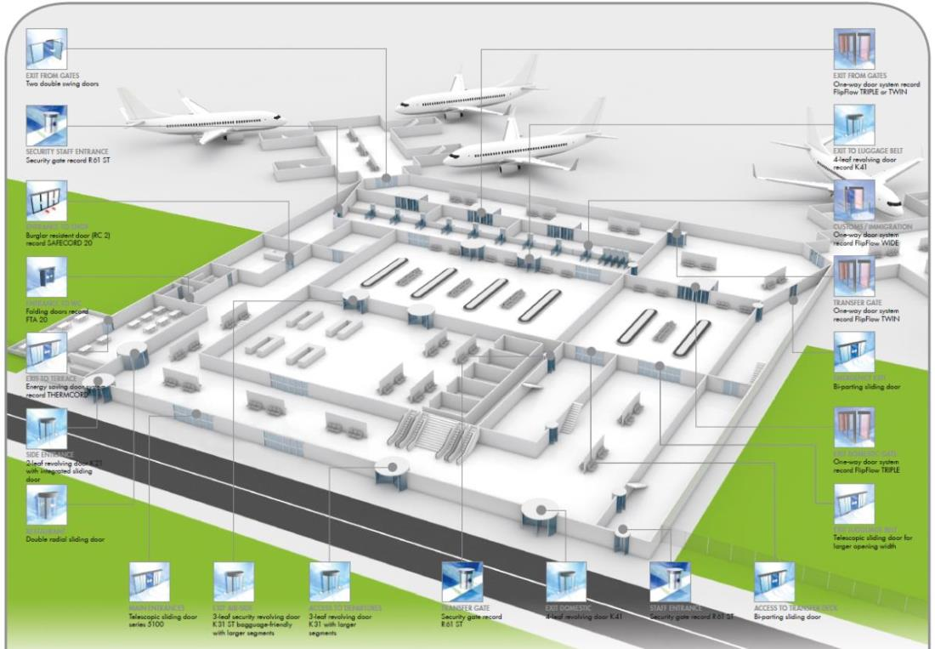
Aviation, transport & security products – that is record!

Slide 3
record FlipFlow – Product video
Download full version of our product video from the webiste and insert it to this slide (local source)
OR
link our youtube video
(online source)

Slide 4
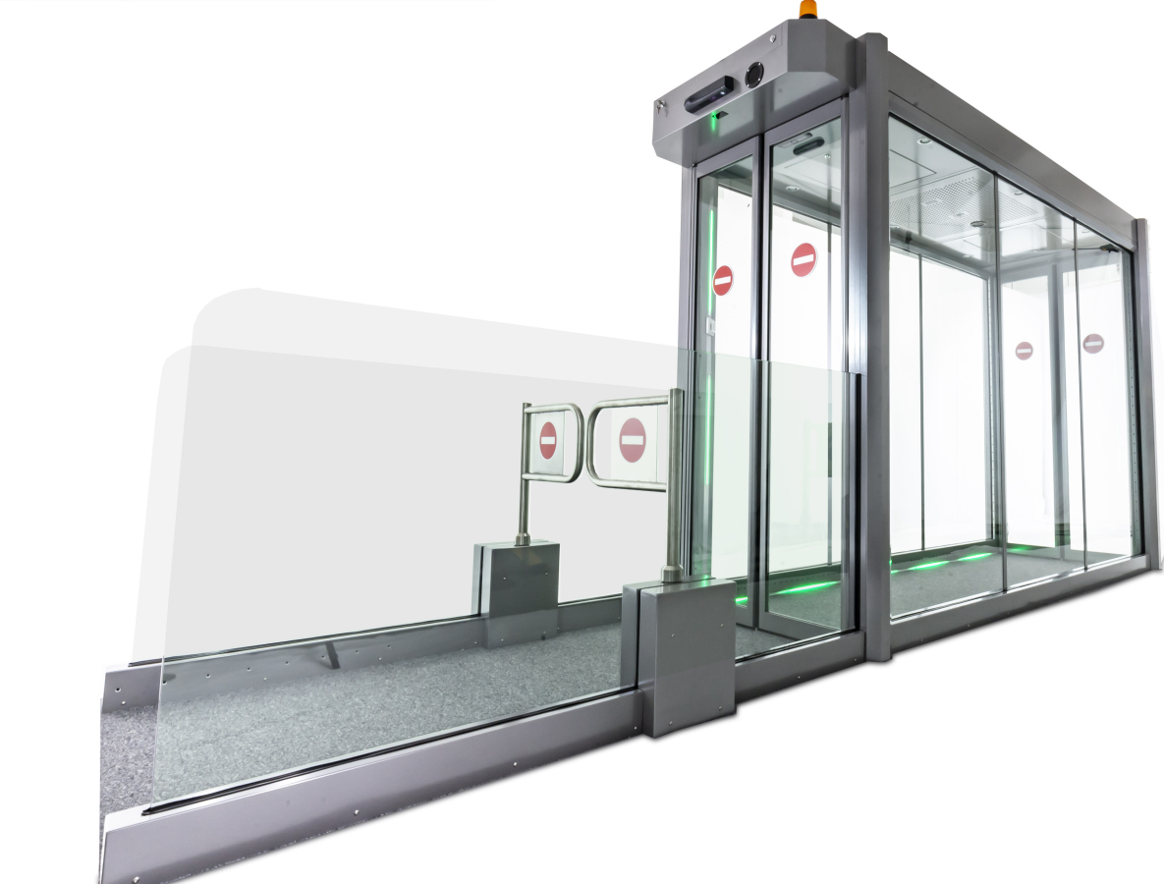
record FlipFlow – Exit Lane Breach Control
Key Benefits
Efficient and economic no-return system with high throughput
Ensure highest level of security and hassle free operation
Allows reallocation or exclusion of security guard staff
Fits easily into existing exit corridors
Side-by-side installations possible
Aluminum or stainless steel versions
Durable modular construction
Less wrong alarms

Slide 5
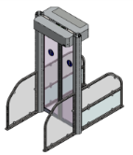
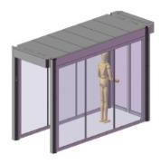
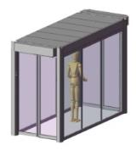
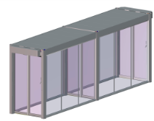
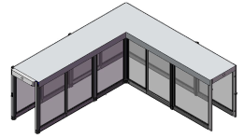
record FlipFlow – product range
record FlipFlow – system scale
FlipFlow Version | WIDE | SINGLE | TWIN | TRIPLE | Customized lane designs | Option: extended
record security level | ★ |  |  |  |  | +1
Auto flow/interlock mode | – | – | ● | ● | ● | ●
Throughput flow | 3600 – 4500 per hour |  | 3600 - 4500* per hour |  |  | No influence
Throughput interlock | n/a |  | Approx. 500 per hour |  |  | No influence
Passage widths | All products available with 650, 900, 1100mm, (1200mm) passage width
Surface | All products available in Aluminum (RAL colors) or stainless steel construction
Security level

Slide 6
record FlipFlow – product range
record FlipFlow – system scale
FlipFlow Version | WIDE | SINGLE | TWIN | TRIPLE | Customized lane designs | Option: extended
record security level | ★ |  |  |  |  | +1
Application examples | Barrier between airside / landside After/before baggage claim Exiting customs or used as a secure emergency egress opening Transition areas to secure zones Exit areas in airports Customs exit Passport control
Side-by-side installation | Available for all products – 2, 3, 4, 5, n..
Security level

Slide 7
A broad portfolio to meet specific flow & security requirements
Passage widths Passengers with….
 | 650mm | 900mm | 1100mm (1200mm) | 1400mm
 | hand luggage and/or bord trolleys | + hold /checked luggage | + baggage carts + special luggage + special assistance | + cargo
Passage height | 2150mm Standard
 | Other passage heights on request

Slide 8
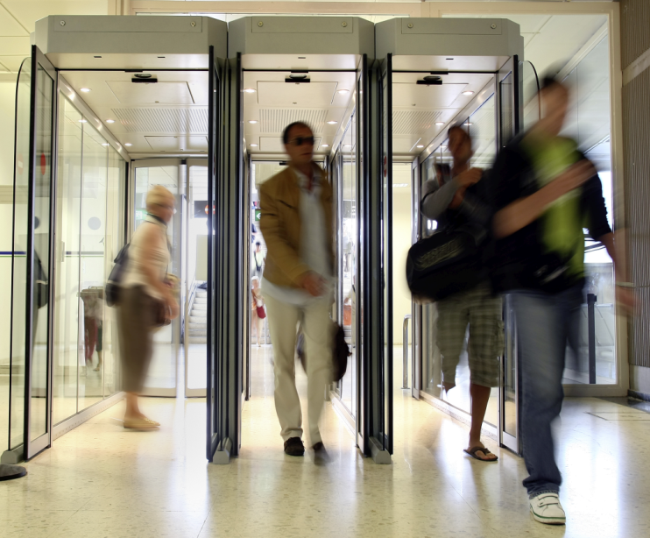
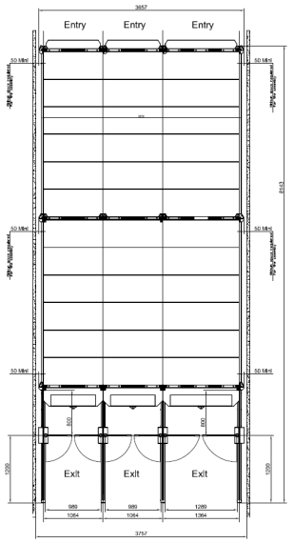
Throughput examples in Flow mode | Amount of FlipFlows installed side-by-side
 | 2 | 3 | 4 | 5 | …n…
@ 1.0 - 1.5m/s 2.2mph – 5.3mph normal speed | ~ 7’200 / hour | ~ 10’800 / hour | ~14’400 / hour | ~18’000 / hour
@ >1.5m/s or >5,4mph brisk, fast walking | ~ 9’000 / hour | ~ 13’500 / hour | ~ 18’000 / hour | ~ 22’500 / hour
FlipFlow bank with different passage widths possible
e.g. 3 FlipFlows side-by-side:
1x 900mm for passengers with hand & hold luggage
2x 650mm fast lanes for people with hand luggage
Or
1x 1100mm for passengers with special luggage, wheelchairs, baggage carts
2x 900mm for passengers with hand & hold luggage
900mm
650mm
650mm

Slide 9
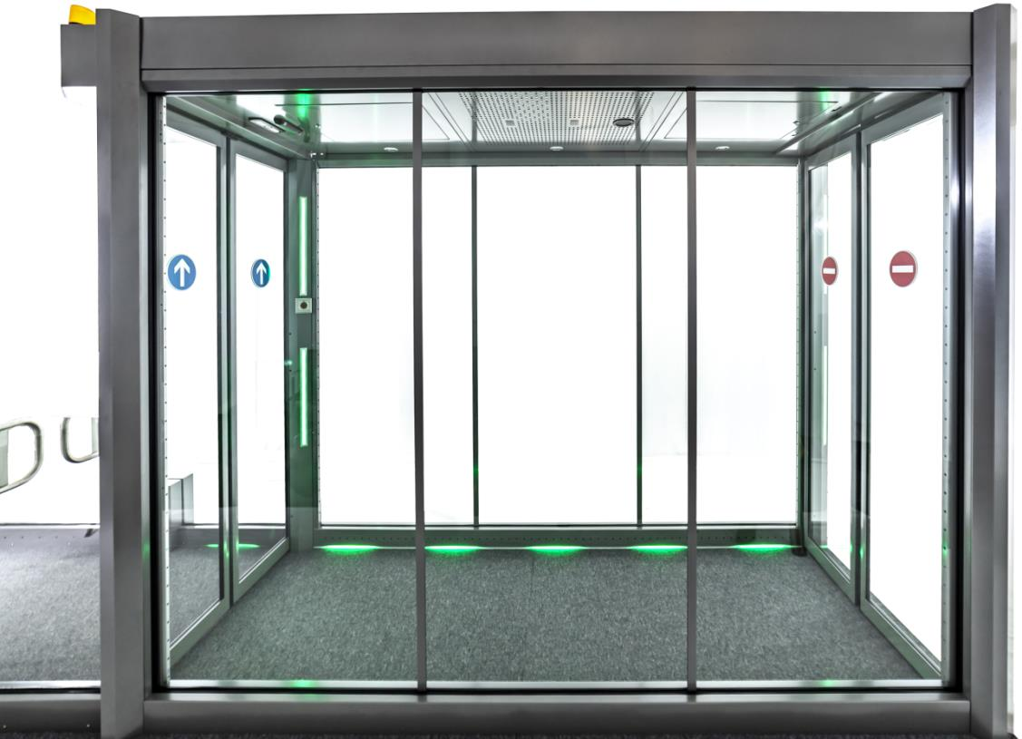
record FlipFlow - Innovations (Whats new?)
LED strips in door posts
LED running lights on floor
better passenger guidance
Improved passenger flow
Green: flow mode
Red: backflow/intrusion
Yellow: technical alarm
TOF-3D backflow sensor
Time-of-flight technology
Fast response
Works in total darkness
Less wrong alarms
3D-object tracking
Sabotage detection
1
2
3
1
1
1
3
1
2
2

Slide 10
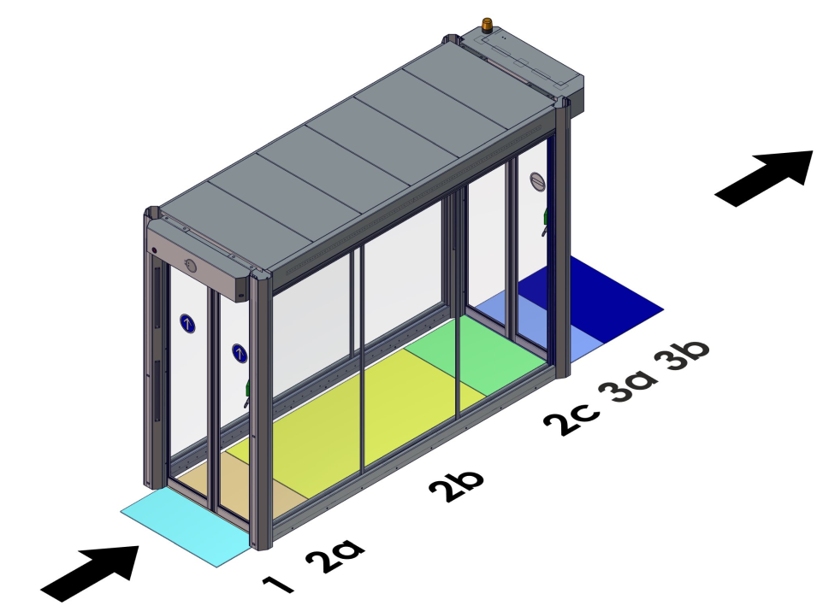
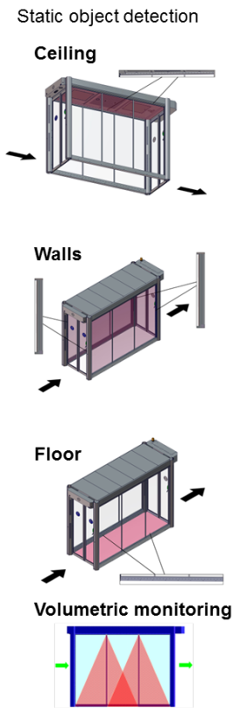
Creating a secure and hassle free environment – example TWIN
Zone → | 1 | Entrance door | 2a | 2b | 2c | Exit door | 3a | 3b
Door Activation | X |  |  |  | X
People Safety |  | X | X |  |  | X | X
Backflow detection |  |  |  |  | X |  | X | X

Slide 11
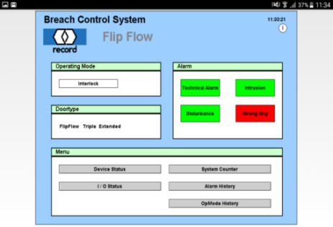
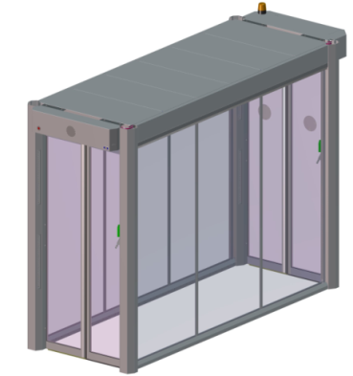
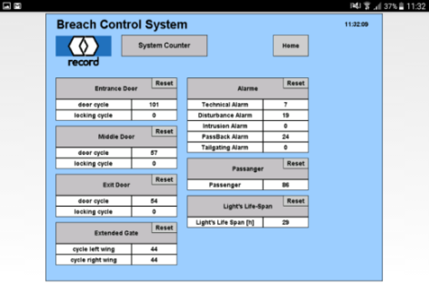
Service/Maintenance via smart devices
Live status of FlipFlow and all sensors/actuators
Live statistics (alarms, cycles, backflow, passenger)
Fast & simple troubleshooting
Use cases:
Internal use: Troubleshooting, setup of FF systems
Airport: Troubleshooting, live status, statistics

Slide 12
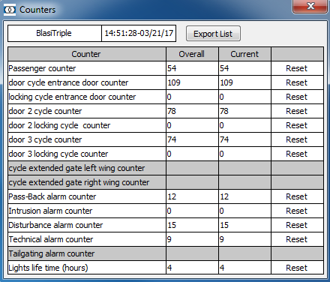
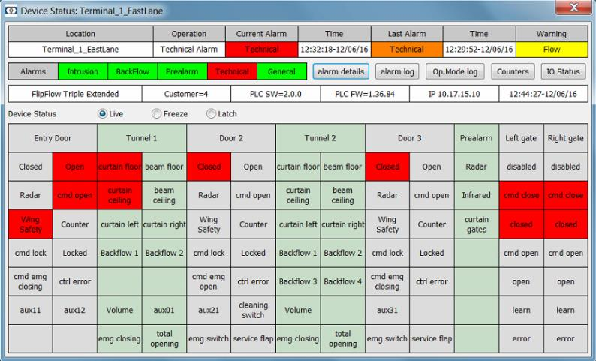
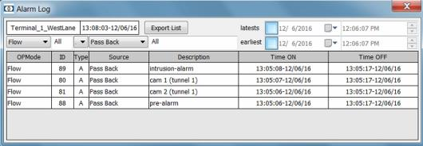
record REAL TIME – FlipFlow Management Software
Outputs/Inputs are configurable
Secure & protected connection
Local area network (LAN)

Slide 13
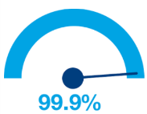
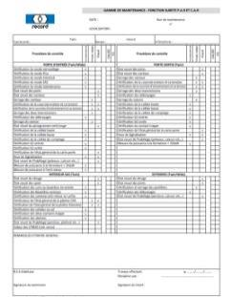
Service/Maintenance + Retrofit promise
uptime
Service & Maintenance
Preventive maintenance (max. 4 visits in a year recommended) → to ensure maximum uptime
We can fix 98% of all FF downtimes instantly, if
All critical spare parts are locally kept
Critical spare parts: part of maintenance agreement, stock onsite
Retrofit promise
Existing FlipFlows can be upgraded with the latest innovations/updates and security improvements, even after years
e.g. a new technology, Halogen → LED, new security features, software updates, hardware upgrades, design updates
Maintenance checklist

Slide 14
record FlipFlow – operating modes
OFF: All doors are closed. Lights off. Red cross at entrance door.
OPEN: All doors are open with breach control active allowing exit-only use for passengers. Breach control can be disabled to allow bidirectional use for airport personnel.
FLOW: Breach control active. Doors open when passengers approach entrance door. After the door closes the secure areas between doors are scanned for left behind objects. Passenger throughput up to 3600 – 4500 persons per hour, per lane.
INTERLOCK: Entry door opens only when the previous passenger has cleared the next door and it has closed. Passengers enter the tunnel, the next door will only open when the previous door has closed. This mode provides the highest security level, however, passenger throughput is reduced to 500 persons per hour, per lane.
AUTOMATIC: System switches automatically between FLOW and INTERLOCK modes depending on the volume of traffic.
EMERGENCY OPENING/CLOSING: Doors open or close by remote signal provided from the airport or emergency open switch in the FlipFlow, backup battery guarantees extended operation in case of power failure.
CLEANING MODE / MAINTENANCE MODE: Exit door opens with a remote signal or key switch provided from the airport, alarm triggers after timeout.

Slide 15
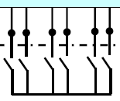
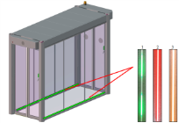
Options (extract)
Programmable Voice module
Connection to Building management systems / security sytems
Digital Inputs / Outputs
Remote control
Ethernet (TCP/IP)
Various indicators (status, alarms, signals..)
Connection to
fire alarm systems & integration of sprinkler
Battery backup in case of a power failure
Emergency open switches / manual unlocking
Various glasses (resistance, opaque…)
Surveillance of service hatches
Handrails

Slide 16
Connection to Building Management or Security Systems
Status signals, alarm signals, operating modes, statistics, passenger counter….
16 Output signals available------------ potential free contacts -------------- 4 Input signals available
Outputs/Inputs are configurable, customer specific solutions possible
Further interfaces
MODBUS/TCP, based on Ethernet
1 | interlock Modus | 9 | open service flap
2 | locked mode | 10 | system in maintenance- /
3 | open mode | 11 | system in operation
4 | flow mode | 12 | entrance door closed /
5 | power failure | 13 | technical fault
6 | exit door closed / | 14 | disturbed people flow
7 | system in cleaning mode | 15 | wrong walking direction
8 | operated emergency-open switch | 16 | intruder alarm / sabotage
 | inactive
 | maintenance mode
 | Locked mode
 | Authorised access
 | open mode
 | Flow mode
 | Interlock mode

Slide 17
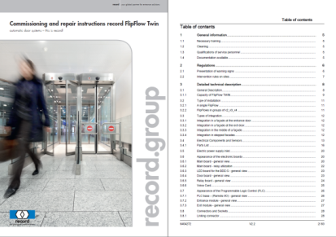
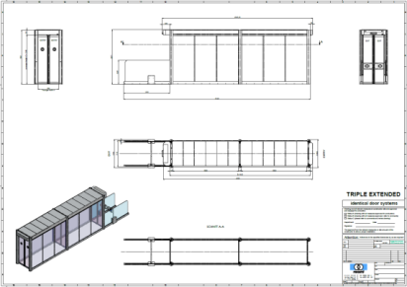
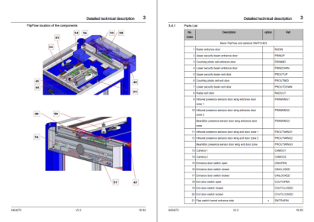
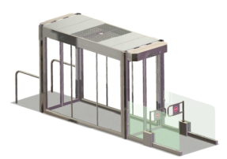
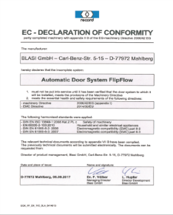
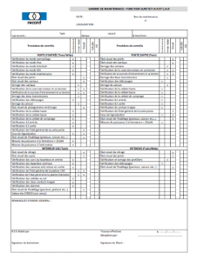
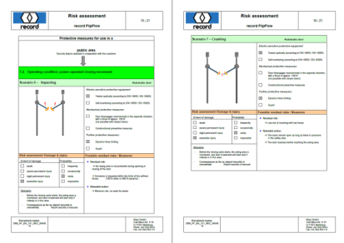
Documentation
Full Technical Documentation in EN / DE / FR available
Tender text
Installation manuals
User manuals
Commissioning/Repair instructions
Maintenance checklists
CE conformities
Risk analysis
Data
Drawings
3D-models
BIM-objects (new)

Slide 18
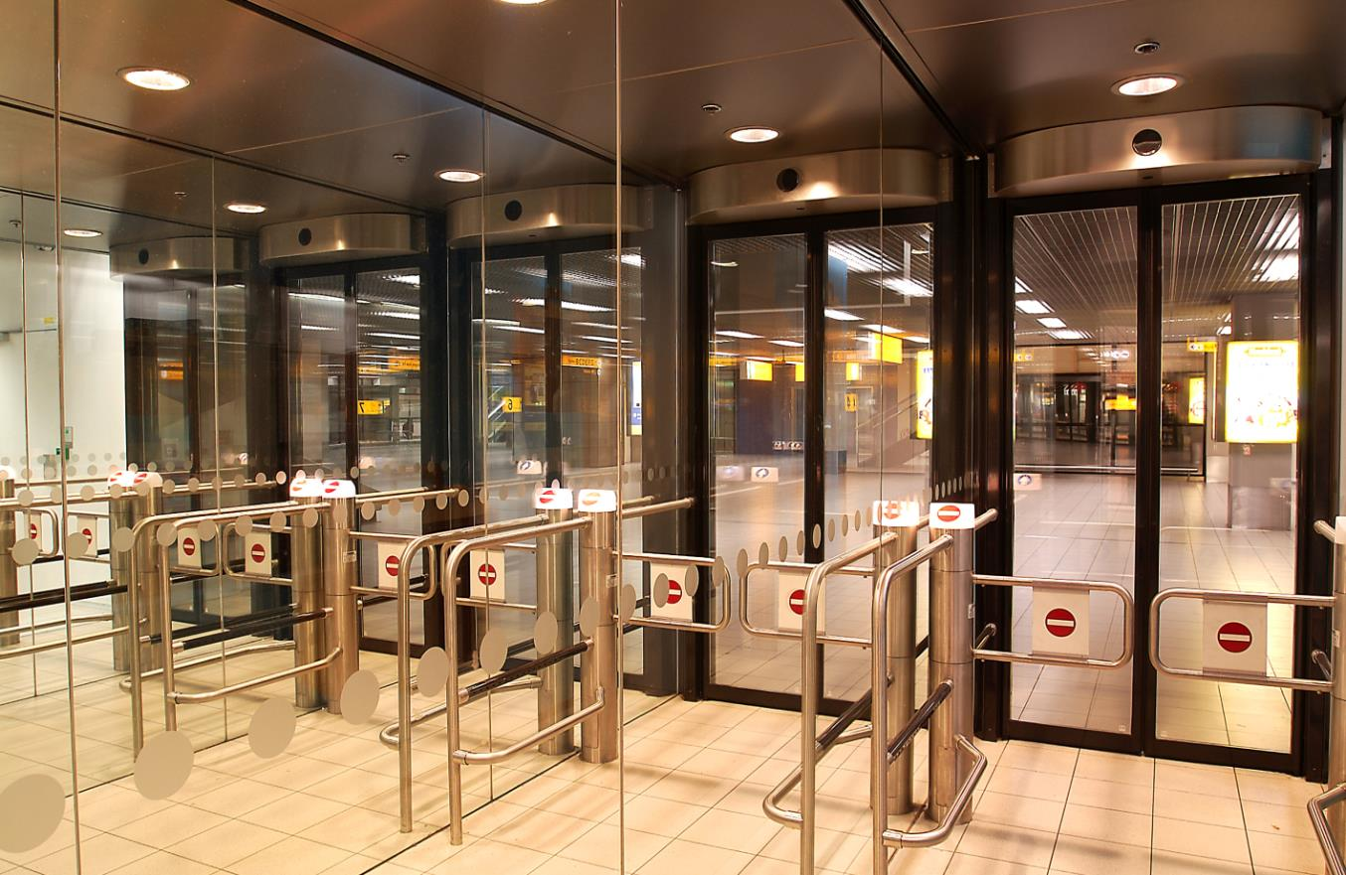
5x record FlipFlow Wide Extended A=1100mm, Stainless steel
Security Rating


Slide 19
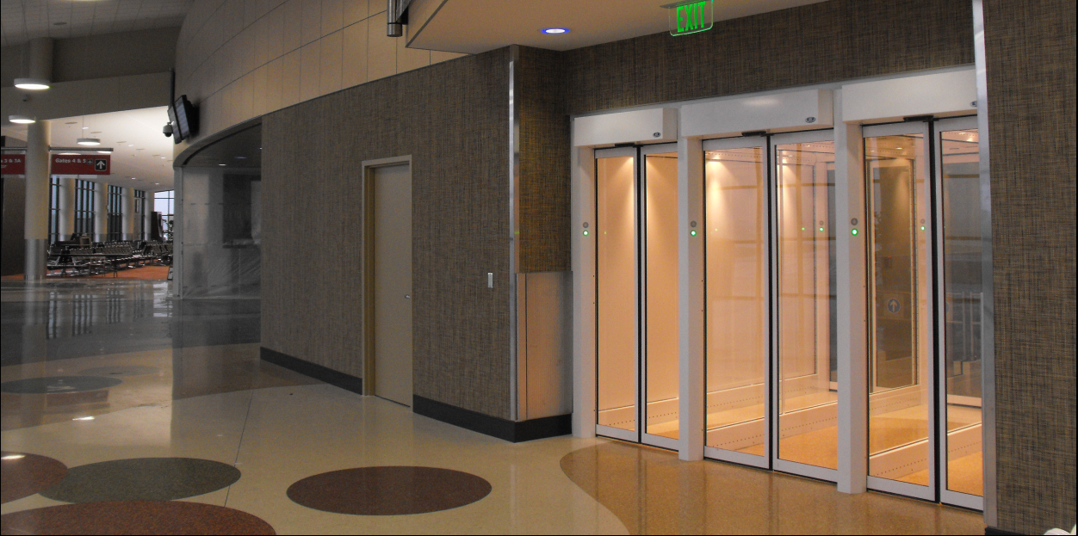
3x record FlipFlow Twin A=650/1100/900mm
Security Rating


Slide 20
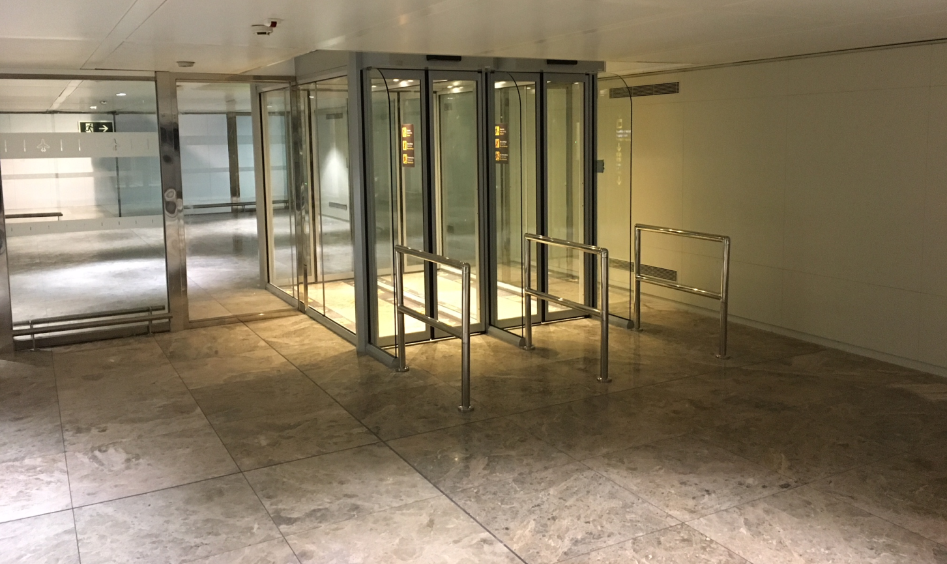
2x record FlipFlow Twin A=900mm with handrails
Security Rating


Slide 21
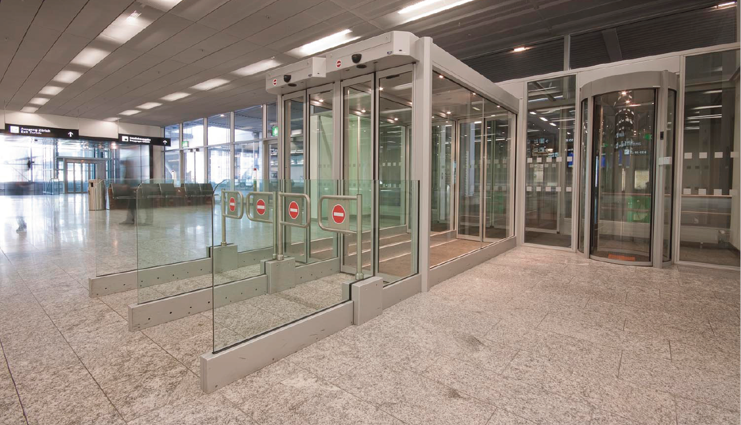
2x record FlipFlow Twin Extended A=900mm
Security Rating


Slide 22
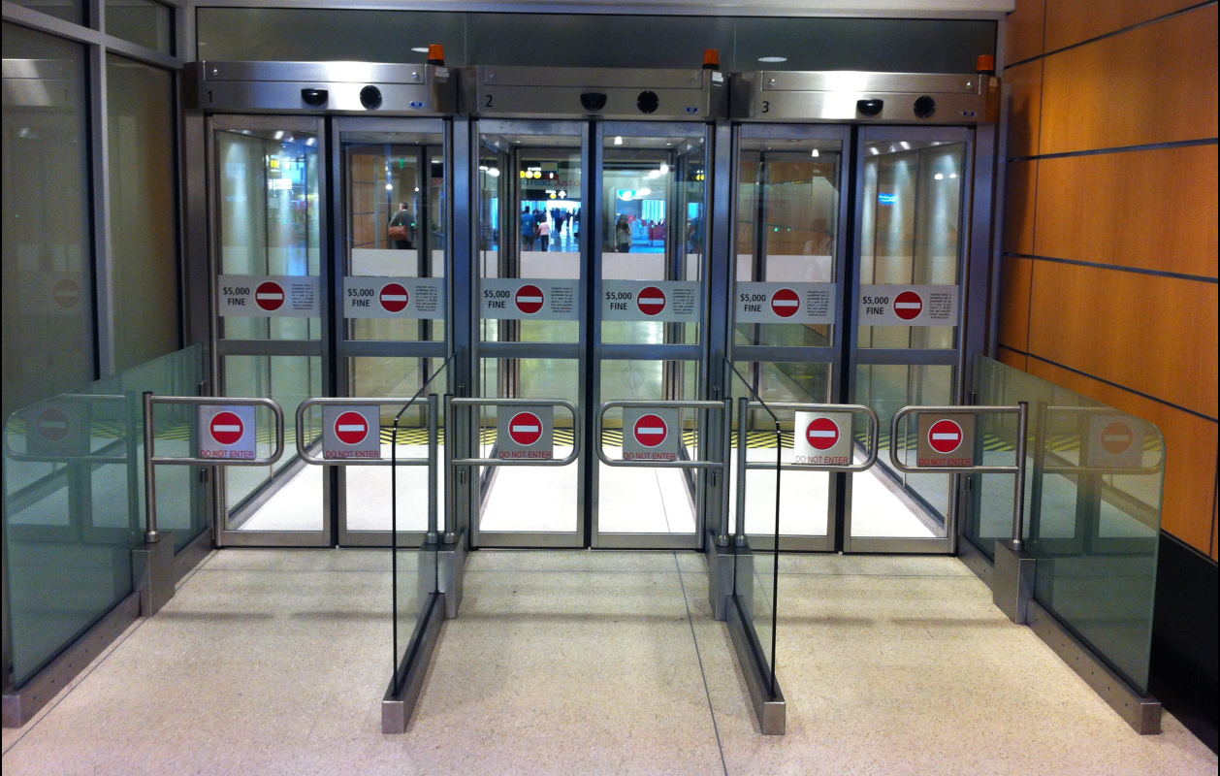
3x record FlipFlow Twin Extended A=1100mm Stainless Steel
Security Rating


Slide 23
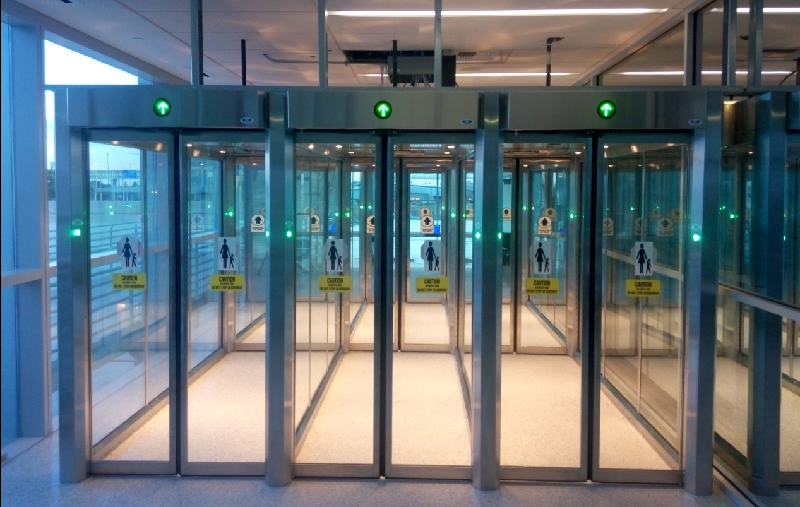
3x record FlipFlow Triple, A=1100mm, Stainless steel
Security Rating


Slide 24
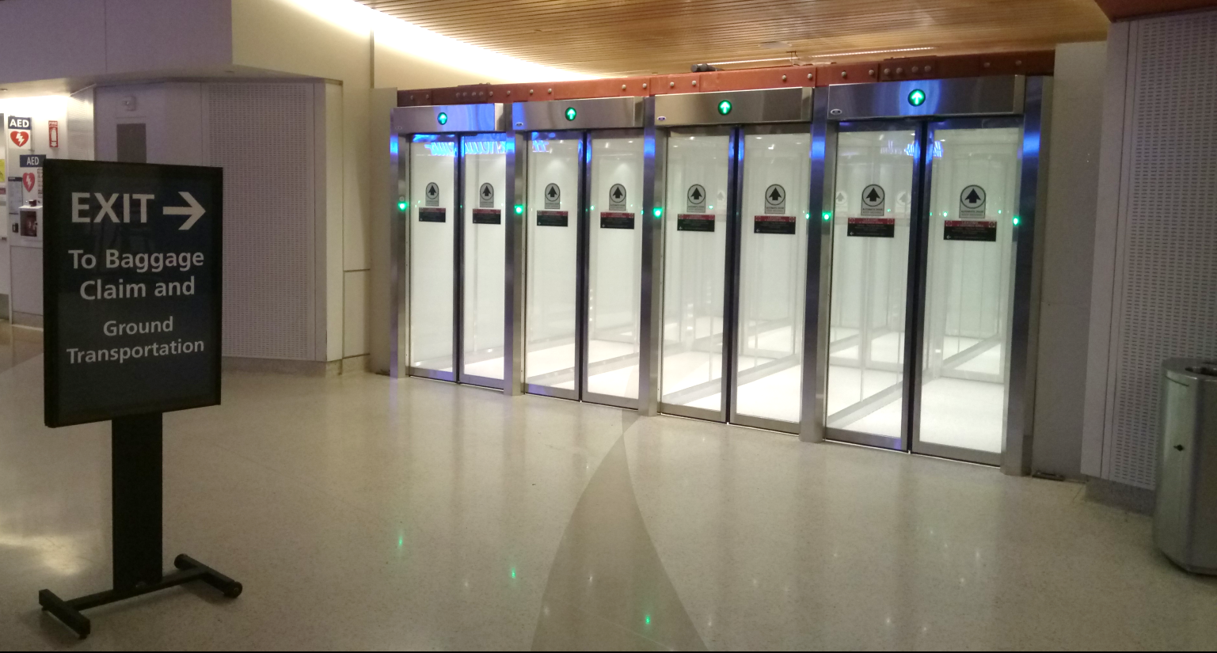
3x record FlipFlow Triple Extended, A=1100mm, Stainless steel, frosted glass
Security Rating


Slide 25
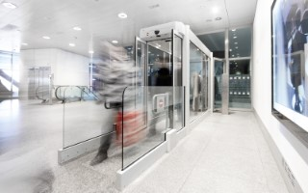
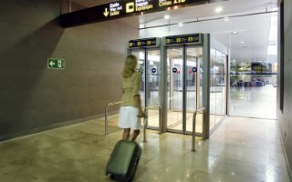
record FlipFlow – references worldwide
USA
Seattle
Kalamazoo
Eugene
Plattsburgh
Lubbock
San Jose
Sacramento
Sarasota
Greenville
Charleston
Minnesota
Canada
Halifax
Fort McMurray
Vancouver
Denmark
Billund
France
Avignon
Bastia
Bordeaux
Cannes
Grenoble
Marseille
Nice
Paris Orly
Strasbourg
Lyon
Netherlands
Amsterdam Schiphol
Spain
Barcelona
Las Palmas
Madrid Barajas
Valencia
Alicante
Gran Canaria
Tenerife
Bilbao
Italy
Florence
Portugal
Lisboa
Germany
Munich
Nürnberg
Stuttgart
Düsseldorf
Karlsruhe/Baden-Baden
Croatia Split
Greece
Athens
Switzerland
Bale-Mulhouse
Zurich
Geneve
United Kingdom
Glasgow
Ireland
Cork
Slowenia
Narocilo Dobavitelju
Belgium
Charleroi
Norway
Sandefjord
Marocco
Casablanca
Saudi Arabia
Riyadh
Oman
Muscat
over 18 years experience in providing reliable exit lane solutions
over 1400+ proven, successful installations throughout the world
highest security level – driven by continuous innovations
many longterm relationships with customers

Slide 26
International relationships and tenders
Longterm collaborations with
Various airport operators
Airport security authorities
…and more…

Slide 27
Thank you
Open discussion

